Slide 1
MUSIC AND AUDIO MANAGER
X
Biel Rubio Dieste

Slide 2
TABLE OF CONTENTS
1
3
Introduction
Spatial audio
2
4
Evolution
Exercise
5
Conclusions

Slide 3
INTRODUCTION
01
X

Slide 4
Why is audio/music important?

Slide 5
Why is audio/music important?
Sets the tone and atmosphere

Slide 6
Why is audio/music important?
Sets the tone and atmosphere
Enhances storytelling

Slide 7
Why is audio/music important?
Sets the tone and atmosphere
Enhances storytelling
Helps players understand the world

Slide 8
Why is audio/music important?
Sets the tone and atmosphere
Enhances storytelling
Helps players understand the world
Creates a memorable experience

Slide 9
EVOLUTION
02
X

Slide 10
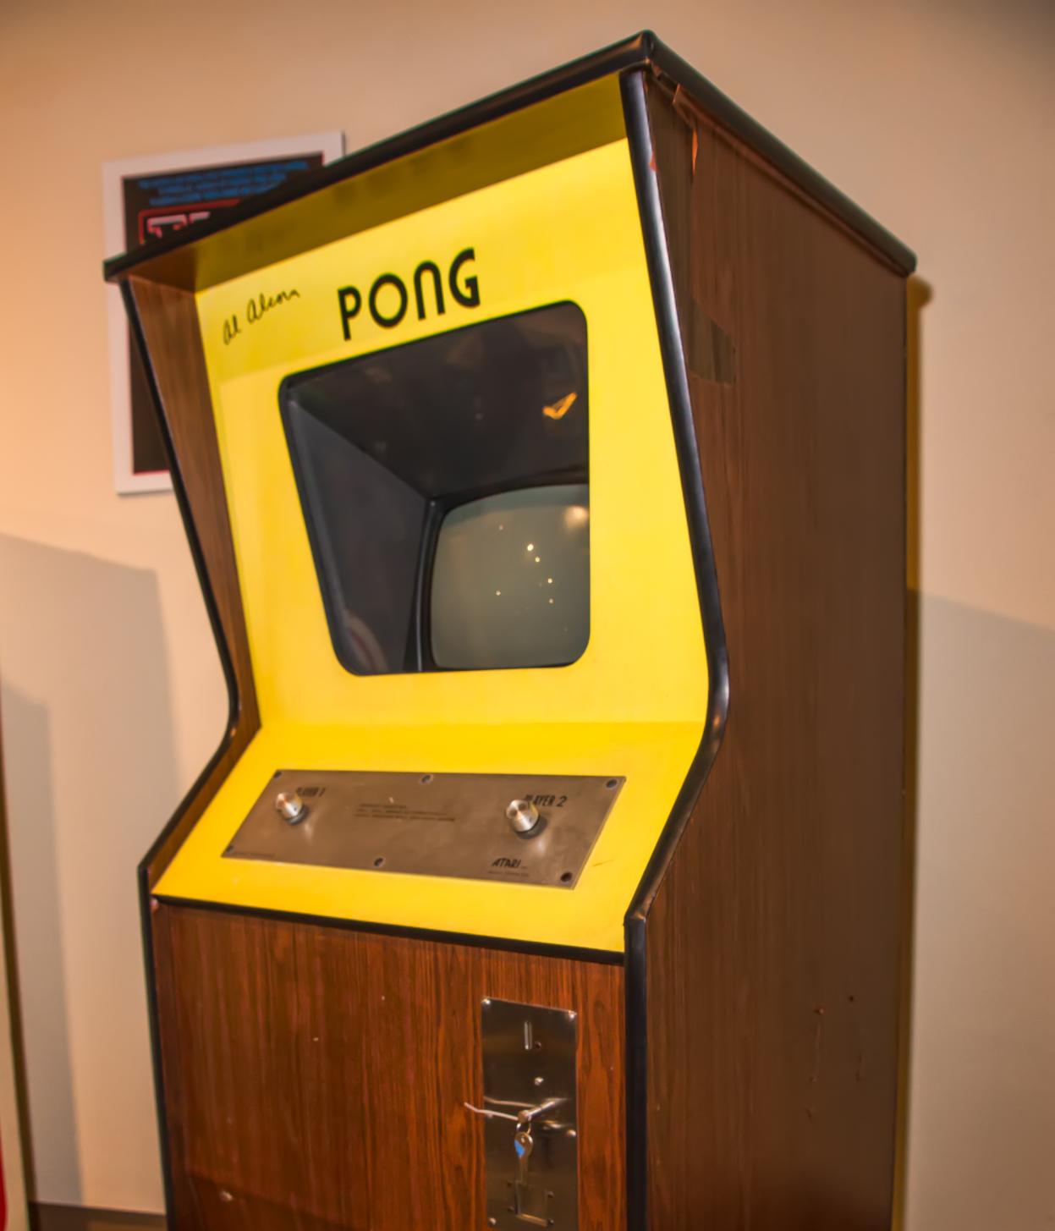
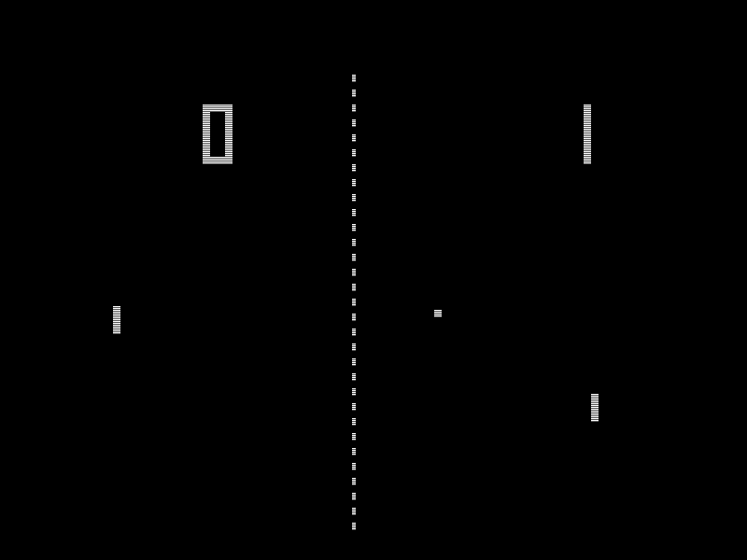
First game with FX
Arcade cabin of Pong (1972), made by Atari
Pong (1972)

Slide 11

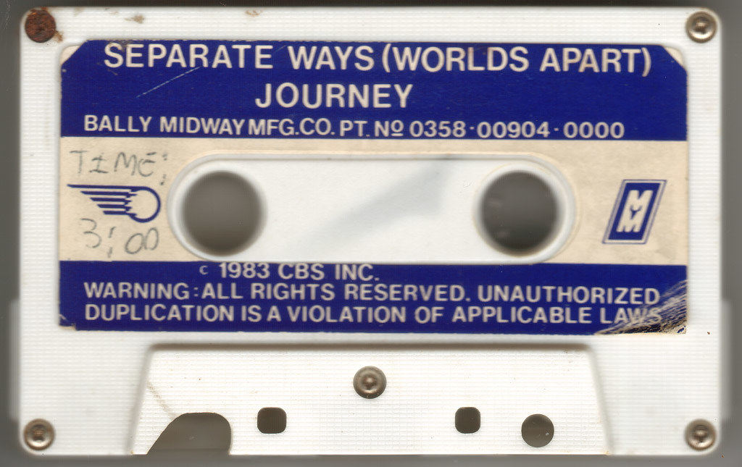
First game with FX
Separate Ways (Worlds apart)cassette
Journey (1983)

Slide 12
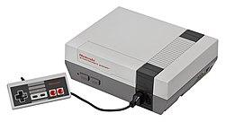
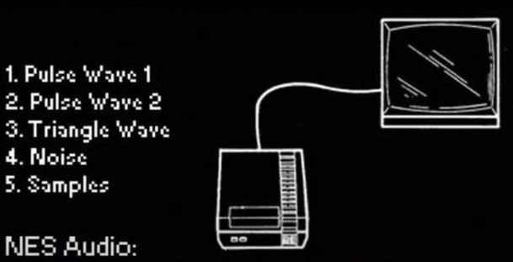
First generation consoles
NES Audio Ports
Nintendo Entertainment System (NES)

Slide 13
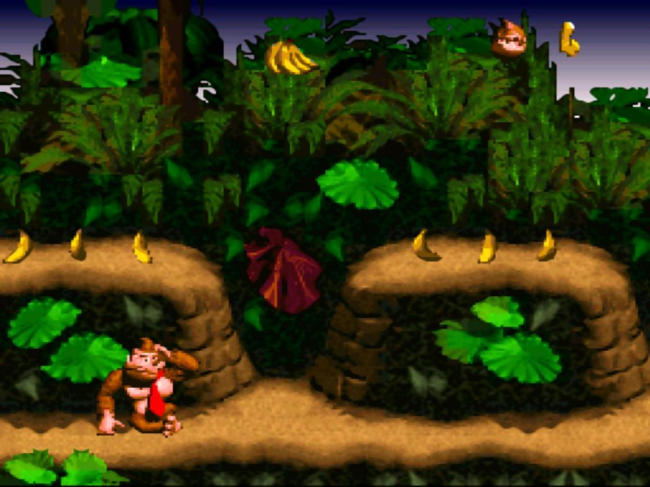
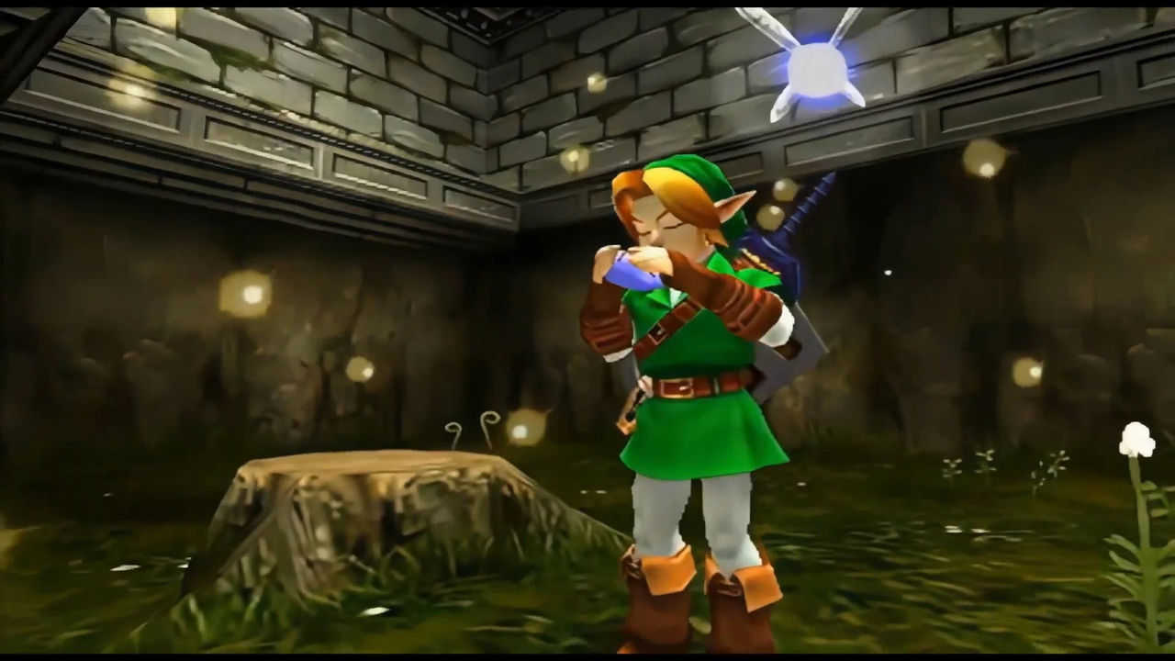
Hardware upgrades
Donkey Kong Country
The Legend of Zelda: Ocarina of Time

Slide 14
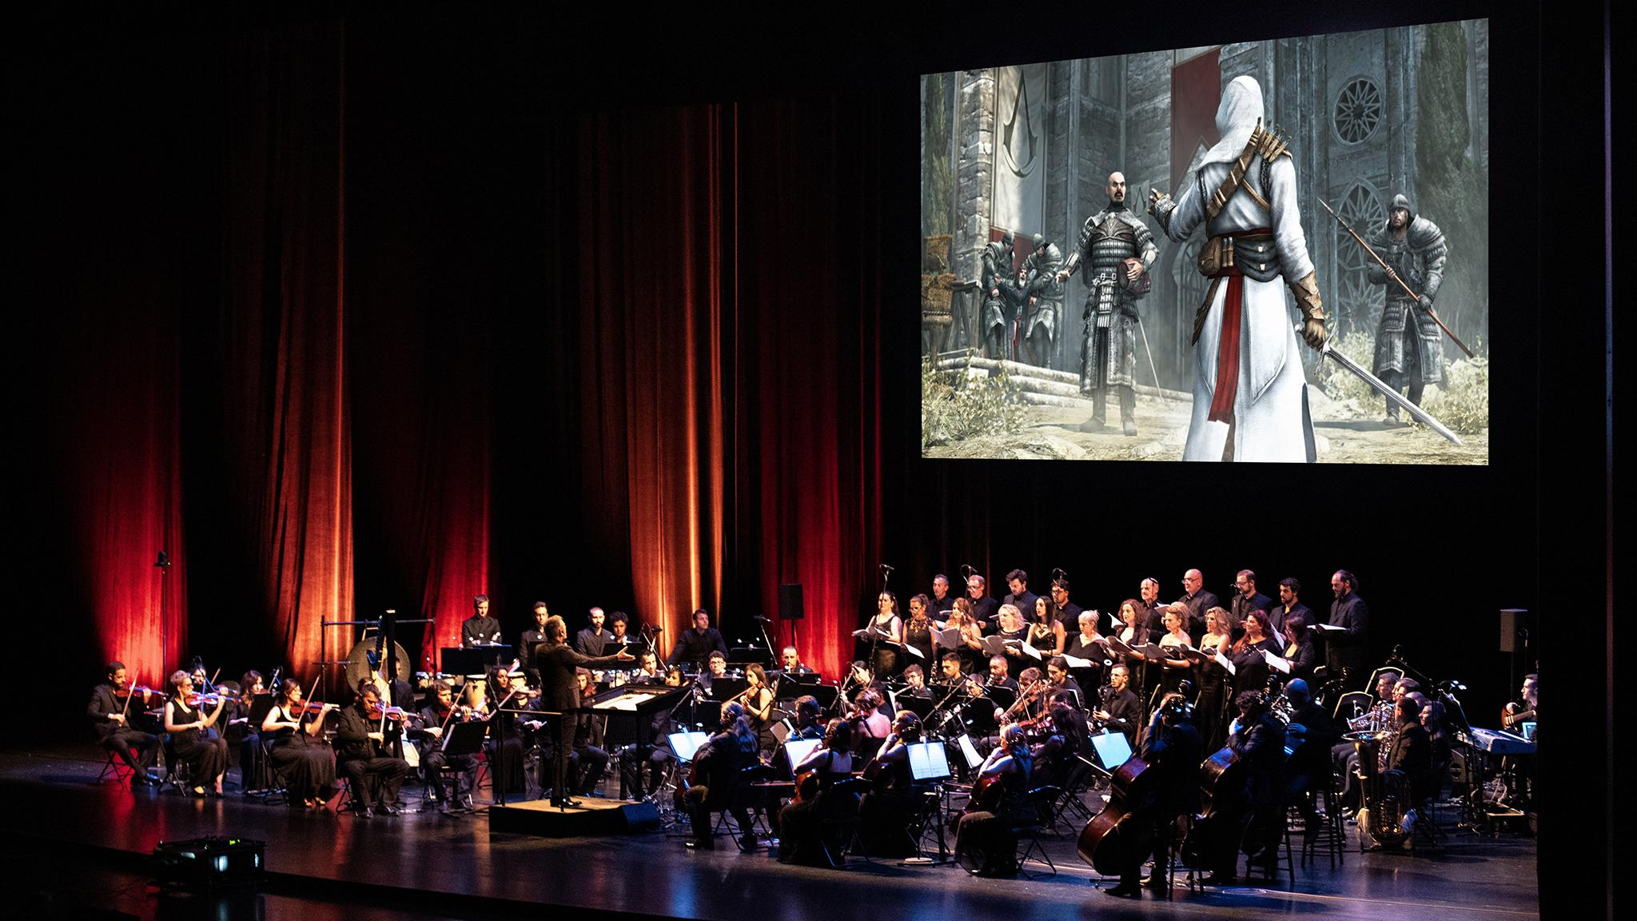
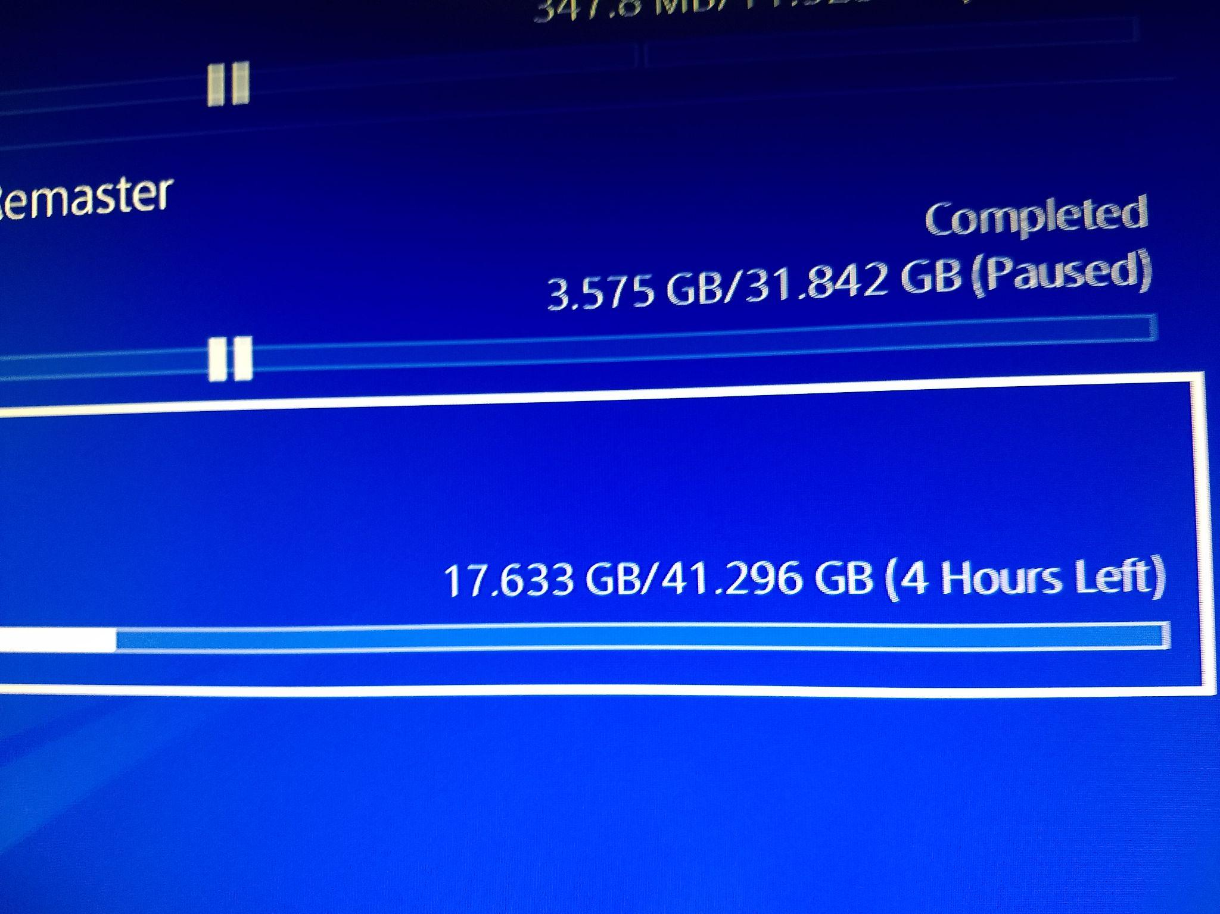
Modern day
An Assassin’s Creed Symphony concert in Paris

Slide 15
SPATIAL AUDIO
03
X

Slide 16
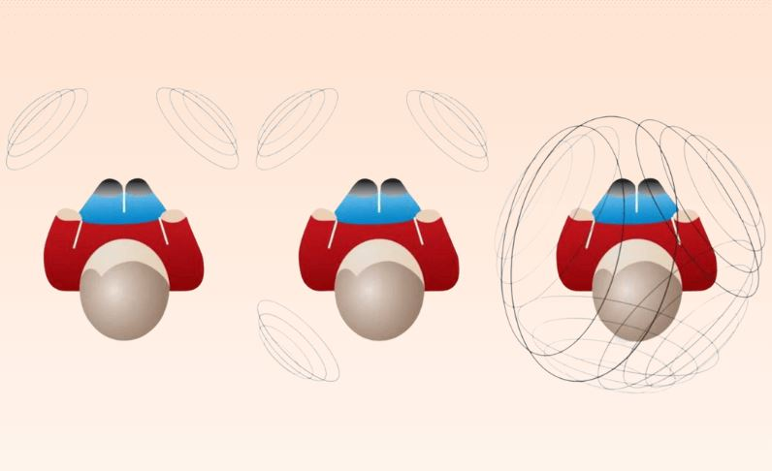
What’s Spatial Audio ?
Technology that creates an immersive and realistic 3D sound experience.

Slide 17

How does it work ?
Mimicking the way an ear works, by changing:
timing
intensity
frequency

Slide 18
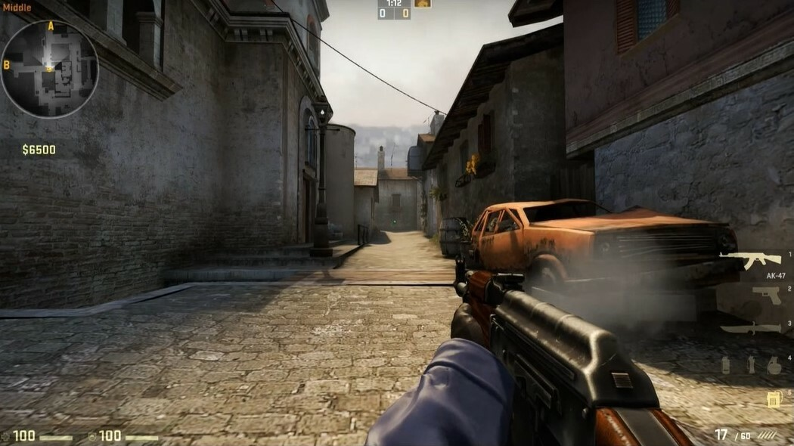
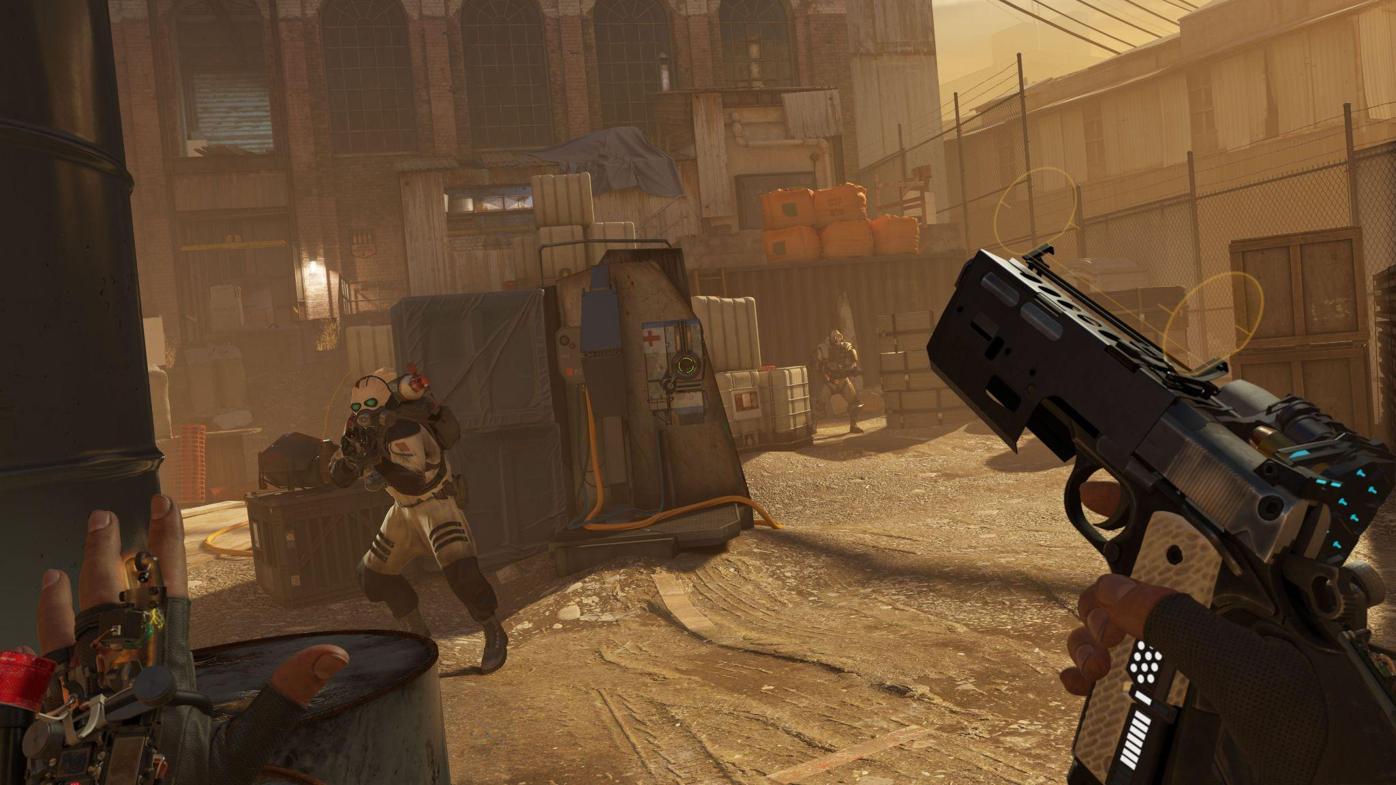
Competitive Games
Realistic Games
Counter Strike: Global Offensive
Half Life: Alyx

Slide 19
What about 2D?

Slide 20
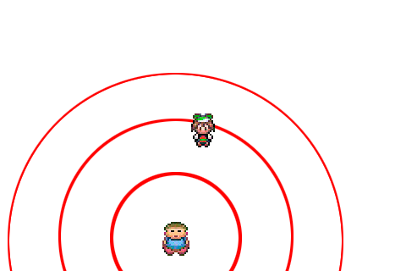
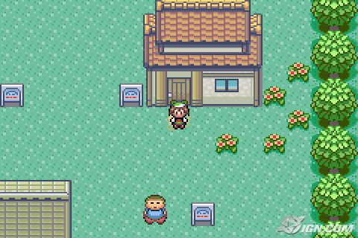

Spatial audio in 2D
Sound Source
Player

Slide 21
Spatial audio in 2D
Play sound if entity is in frame

Slide 22

Spatial audio in 2D
Play sound if entity is in frame
Don’t play sound if out of frame

Slide 23
Spatial audio in 2D
Volume level: 50% - 75%

Slide 24
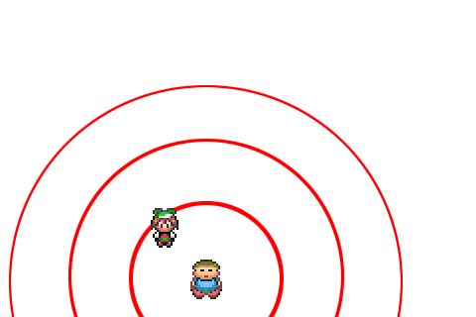
Spatial audio in 2D
Volume level: 100%

Slide 25
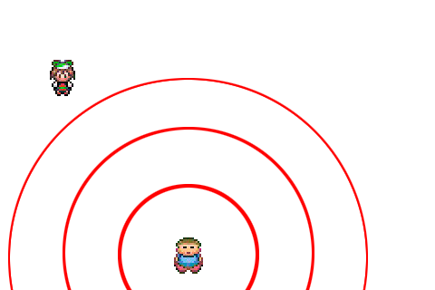
Spatial audio in 2D
Volume level: 0%

Slide 26
EXERCISE
04
X

Slide 27
Exercise
Spatial Audio for Entities sFx
Audio playlist for a Scene

Slide 28
Exercise: Spatial audio
TODO nº1
-Check for distance between player/entity
and change volume accordingly (audio.cpp)
-Check if entity is on camera frame (audio.cpp)
-Play sound Fx (audio.cpp)

Slide 29
Exercise: Spatial audio
TODO nº2
-Initialize Fx (chest.h)
-Load Chest Fx (chest.cpp)
-Call Spatial audio function (chest.cpp)

Slide 30
Exercise: Playlist
TODO nº1
-Create Track struct (audio.h)
-Create playlist (list of tracks) (audio.h)

Slide 31
Exercise: Playlist
TODO nº2
-Implement AddTrack() (audio.cpp)
-Load tracks from config.xml (scene.cpp)
-Keep track of Track position (scene.h)

Slide 32
Exercise: Playlist
TODO nº3
-Implement PlayPlaylist() function (audio.cpp)
-Implement ChangeTrack() function (audio.cpp)

Slide 33
Exercise: Playlist
TODO nº4
-Start playlist (scene.cpp)
-Change track on key press (scene.cpp)

Slide 34
Exercise: Playlist
TODO OPTIONAL
-Implement CleanUpPlaylist() (audio.cpp)

Slide 35
CONCLUSION
05
X

Slide 36
THANKS FOR YOUR ATTENTION

